Slide 1

Sweden: Total Fertility Rate
Total fertility rate: 1.67 children born/woman (2012 est.)
Global fertility rates are in decline mostly in industrialized countries, especially Western Europe, where populations are projected to decline dramatically over the next 50 years.

Slide 2
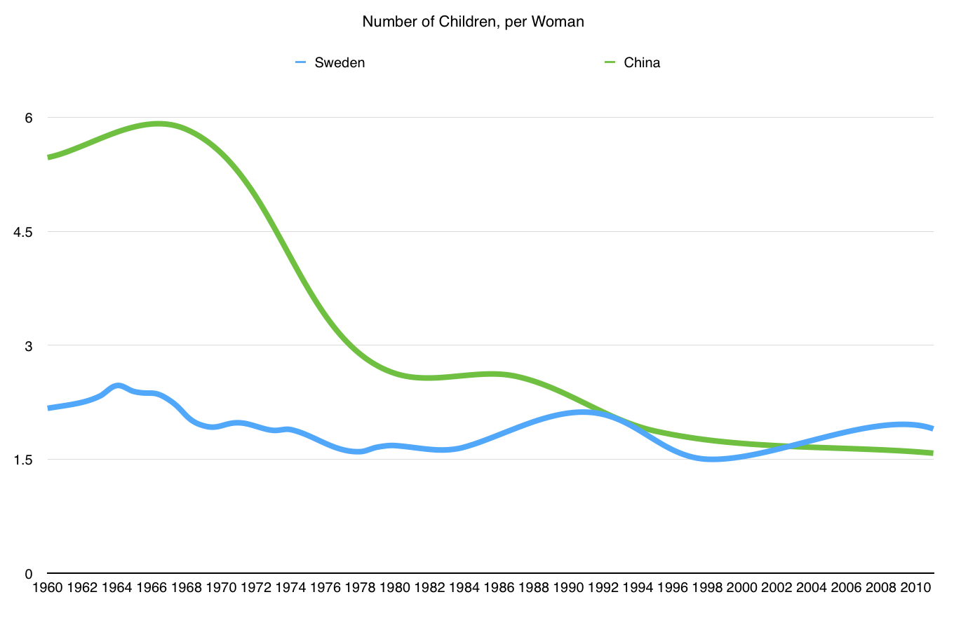

Slide 3
Sweden: Life Expectancy
1960’s - 73 years of age
1980’s - 75 years
By 2000 - 80 years
Life expectancy at birth: 81.18 years
  Male: 78.86 years
  Female: 83.63 years (As of 2012 est.)

Slide 4
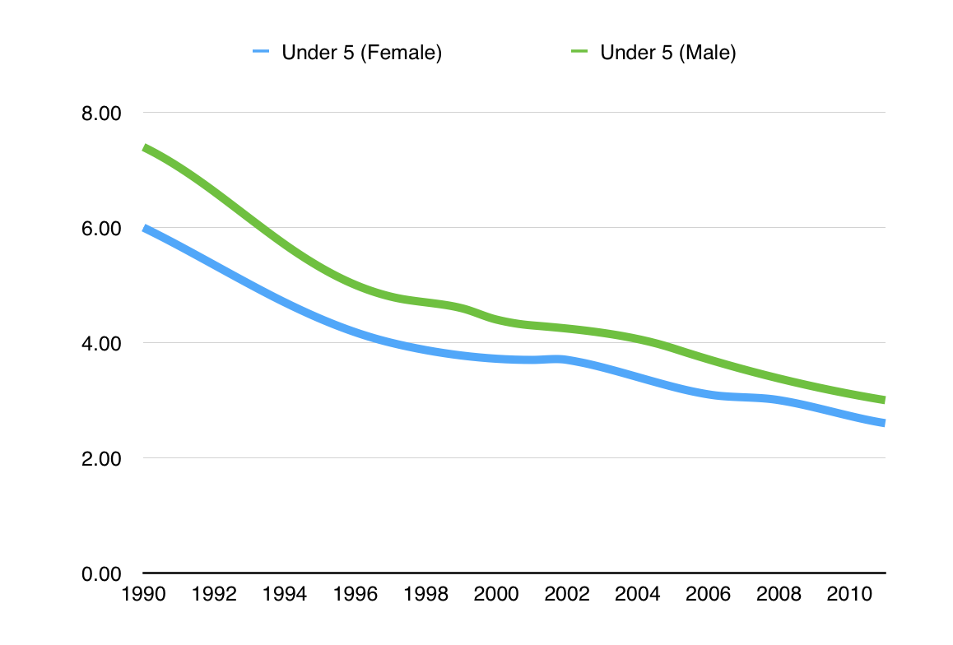
Sweden: Mortality Rates

Slide 5
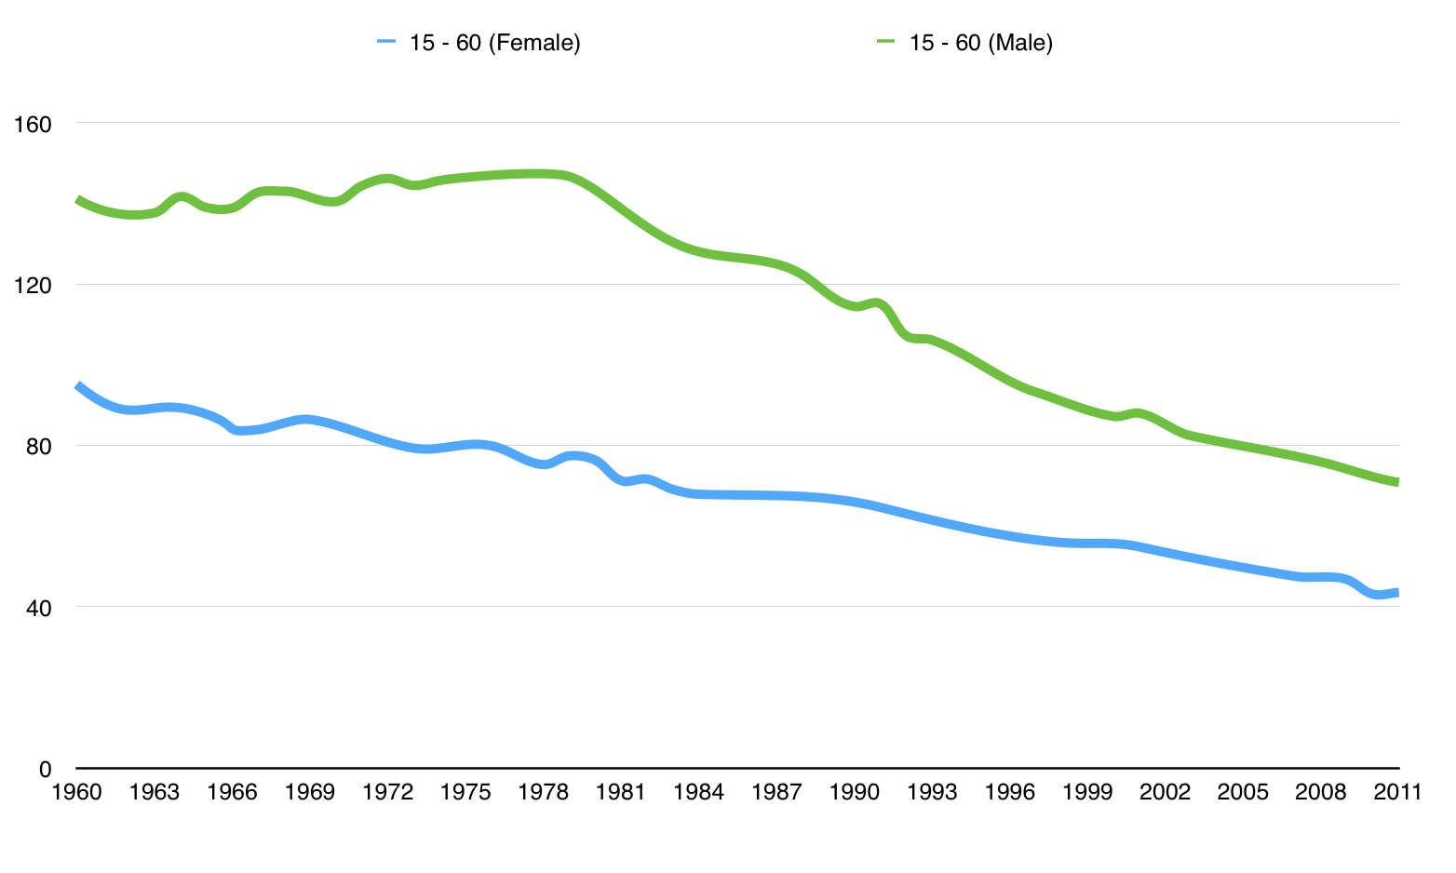
Sweden: Mortality Rates

Slide 6
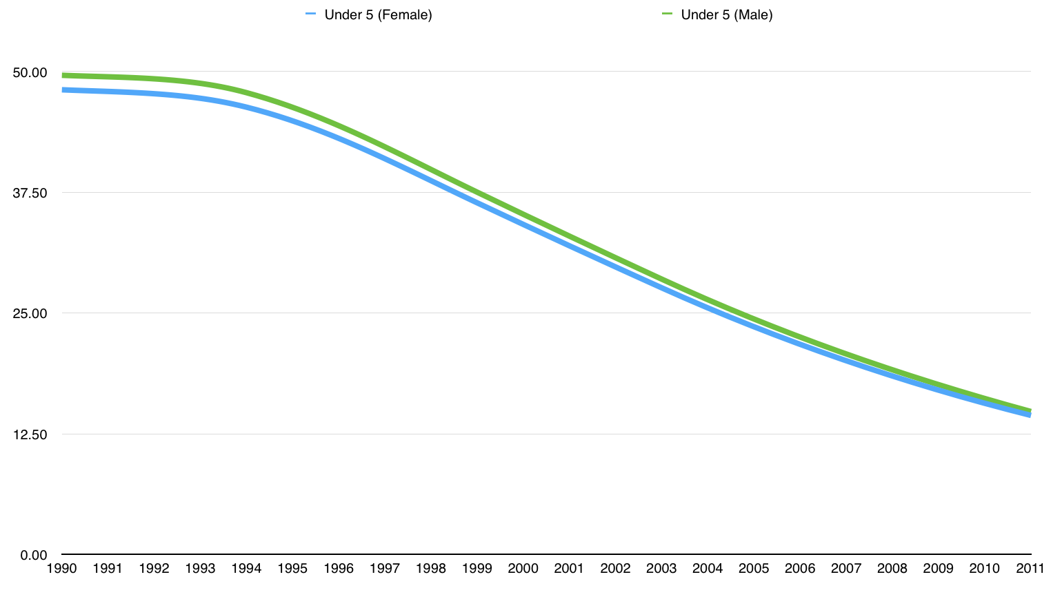
China: Mortality Rates

Slide 7
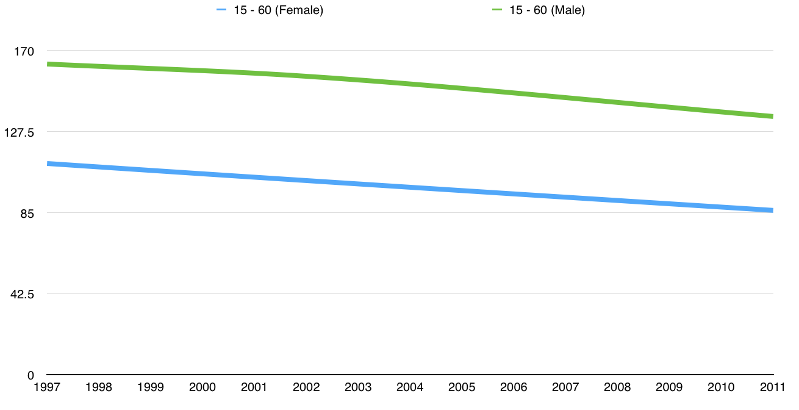
China: Mortality Rates

Slide 8
Sweden: Migration Composition
During 2010 the most common reason for immigrating to Sweden was:
Labor migrants (21%)
Family reunification (20%)
Immigrating under the EU/EES rules of free movement (18%)
Students (14%)
Refugees (12%)

Slide 9
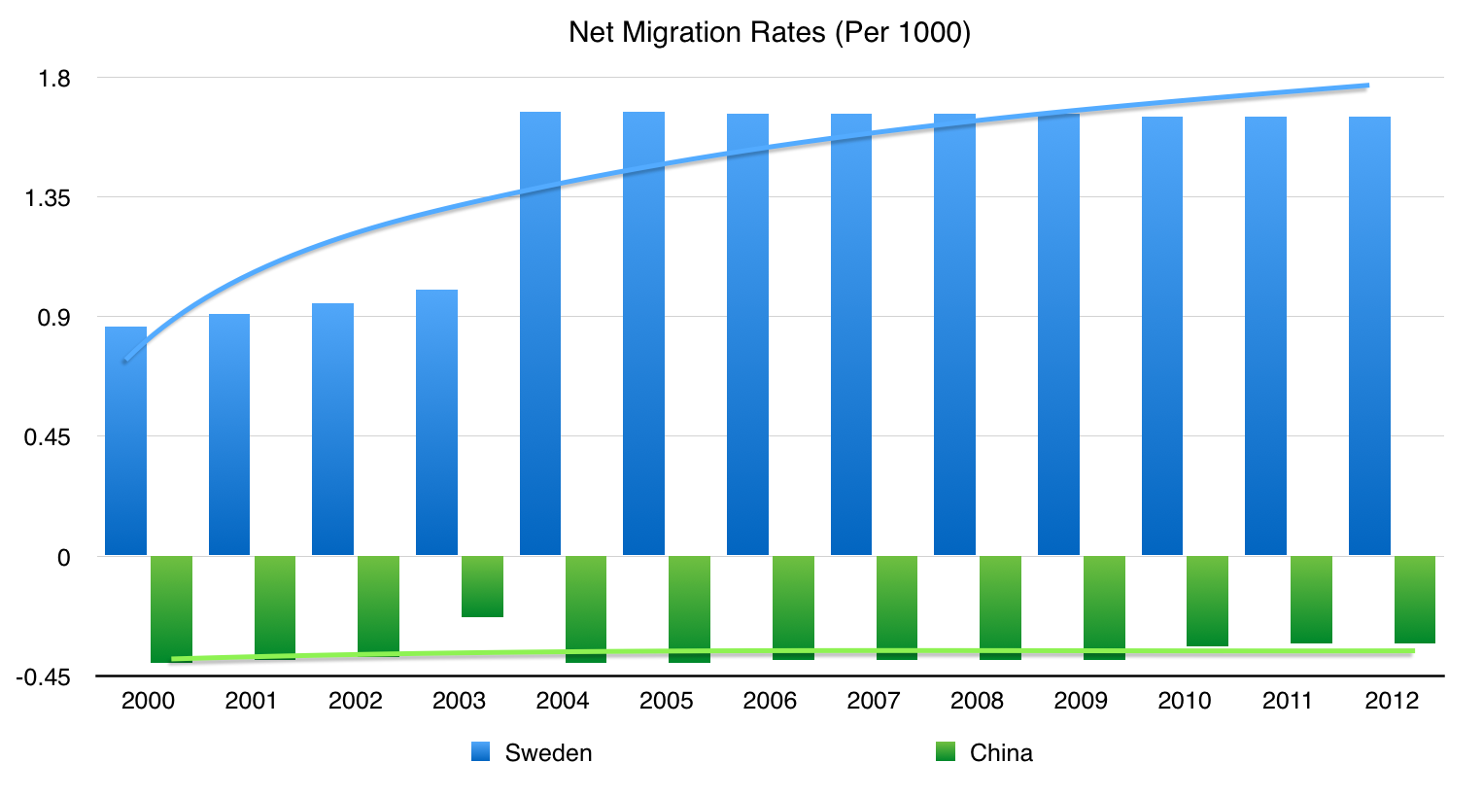

Slide 10
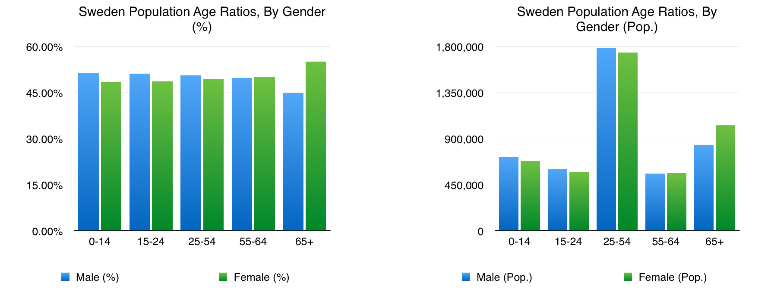
Sweden: Population Structure

Slide 11
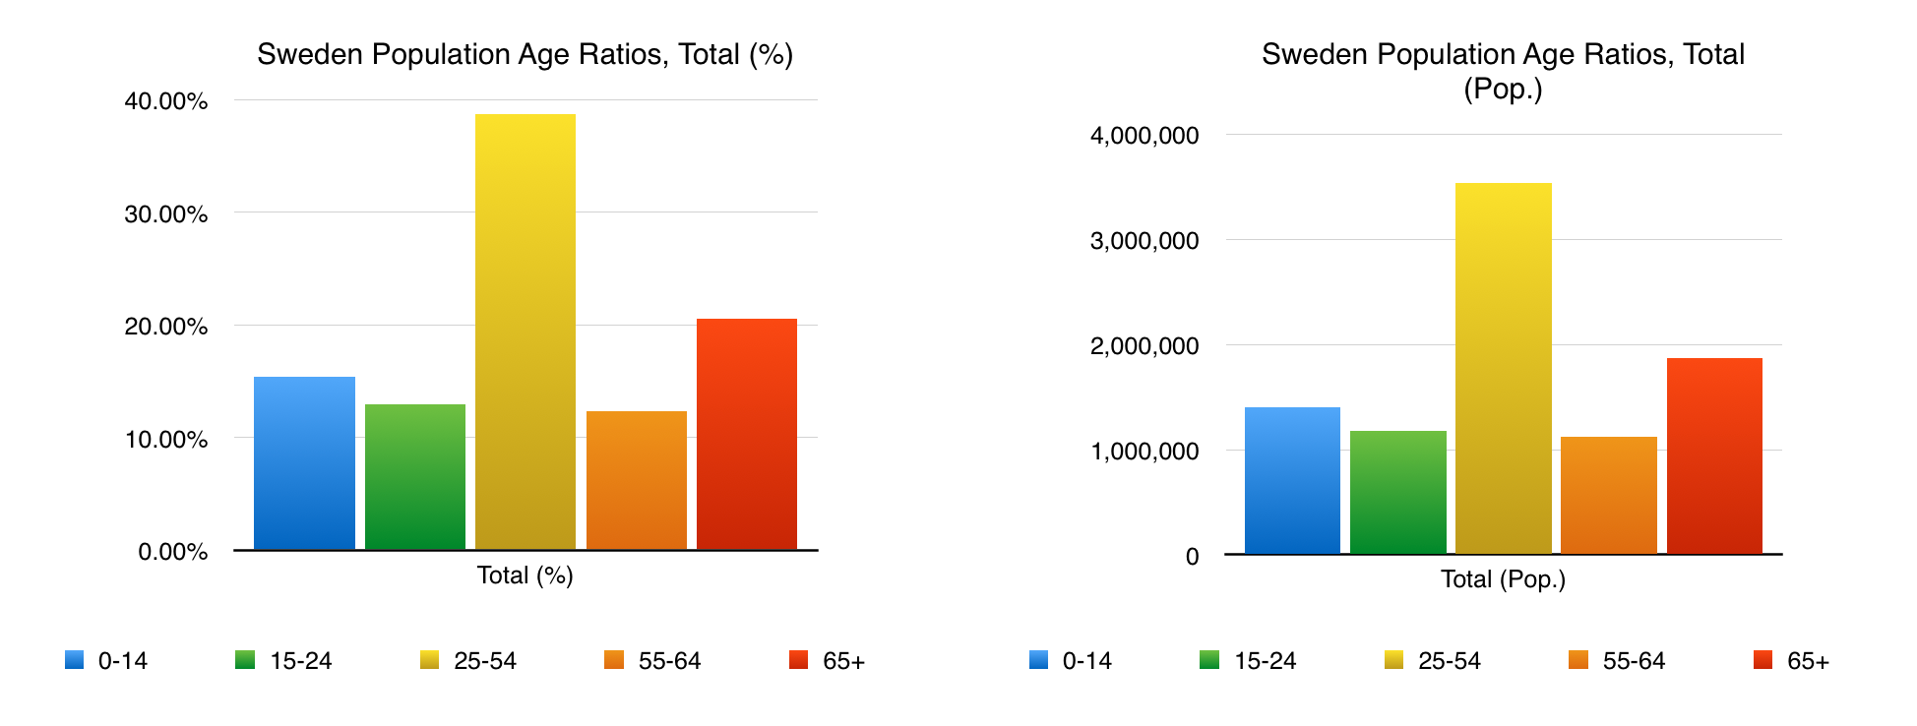
Sweden: Total Population Structure

Slide 12
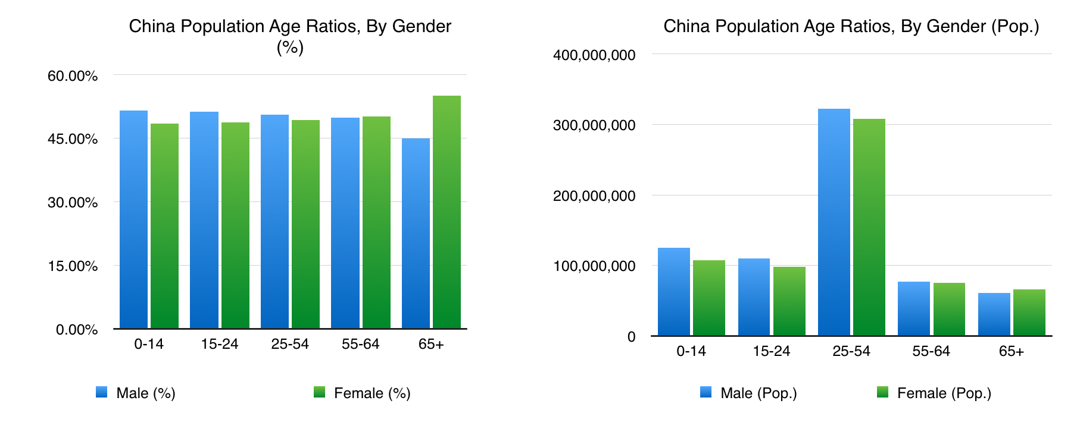
China: Population Structure

Slide 13
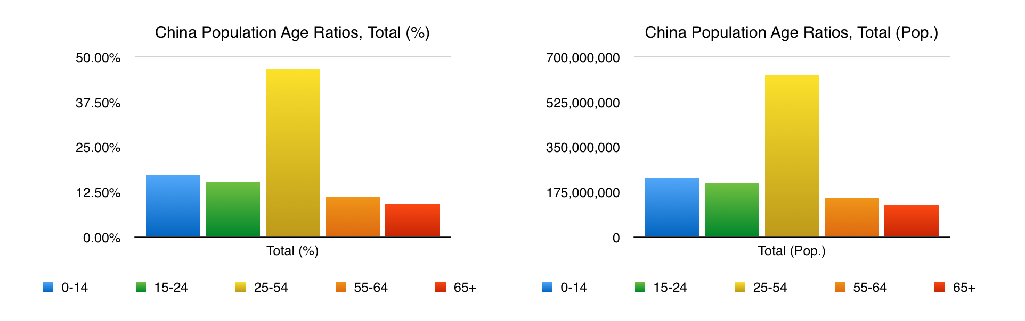
China: Total Population Structure

Slide 14
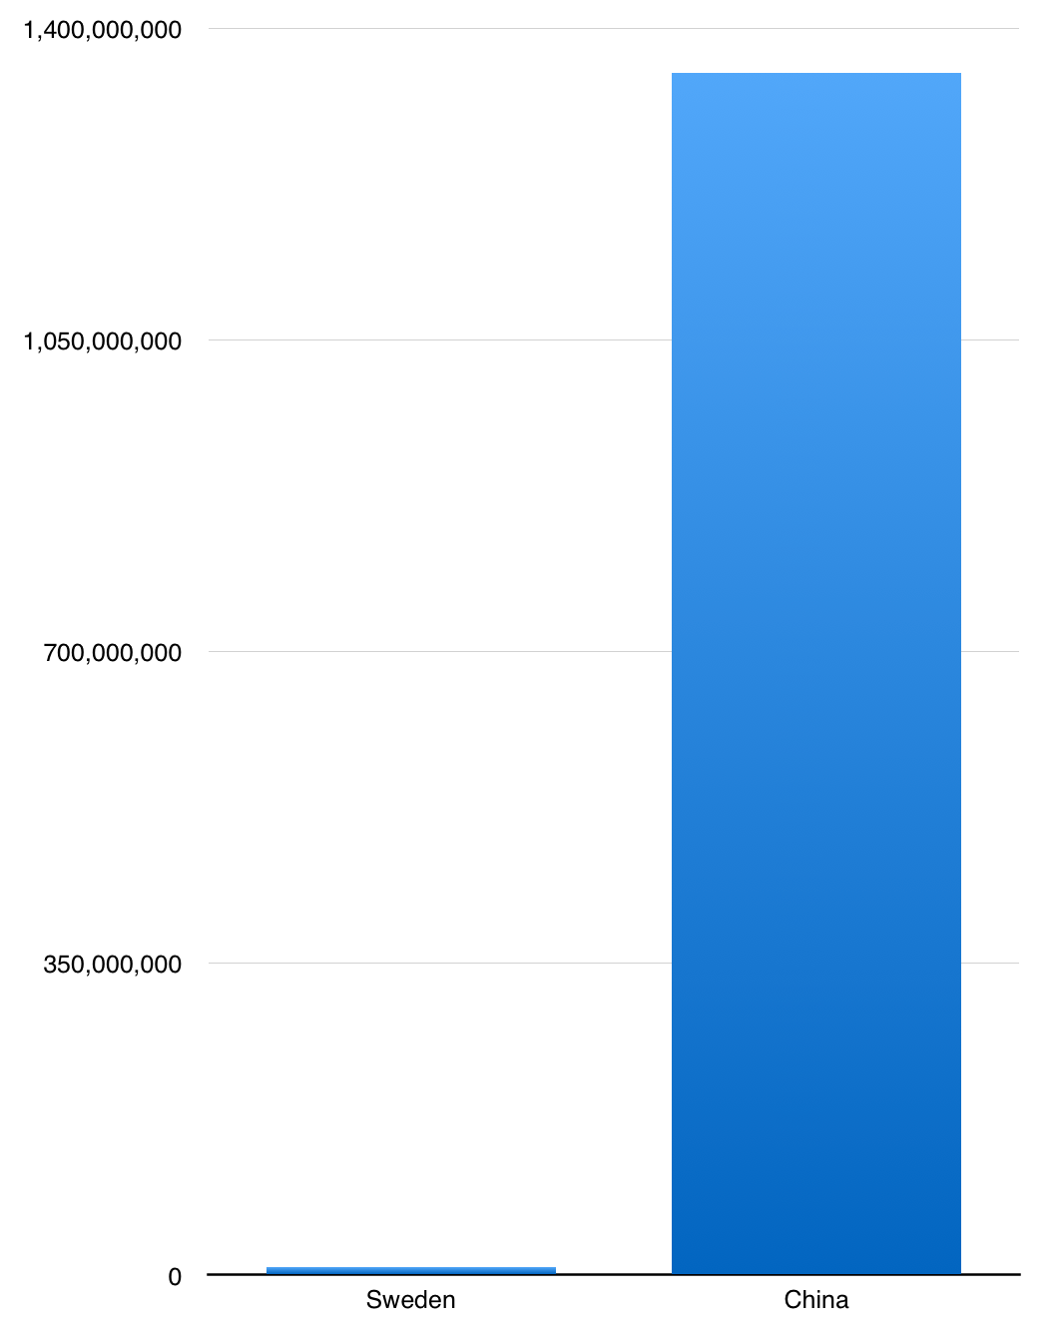

Slide 15
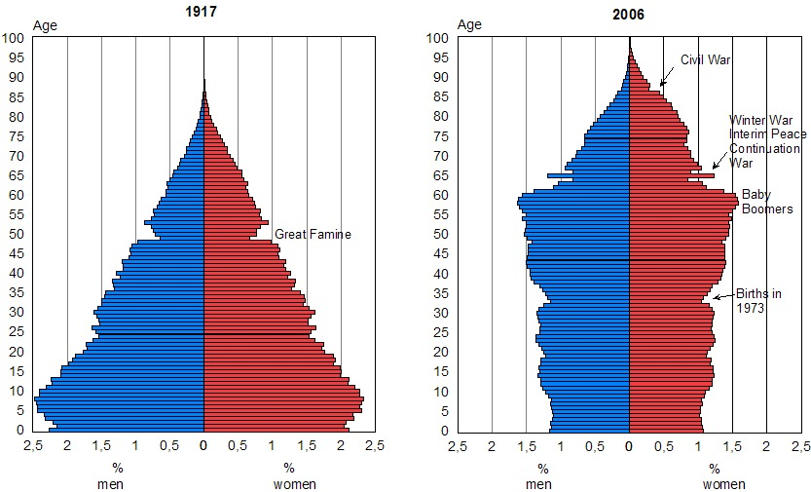
Sweden: Population Pyramid (past)

Slide 16
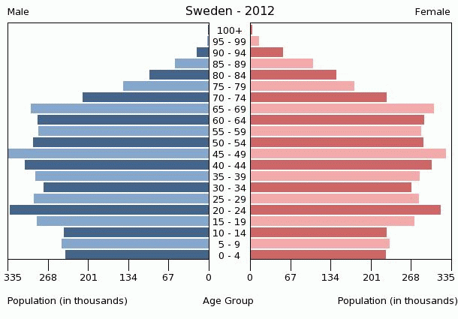
Sweden: Population Pyramid (2012)

